Slide 1
Technical Arts (TA 101AA) Engineering Graphics
Prof. Nachiketa Tiwari
Department of Design

Slide 2
Orthographic Projections

Slide 3
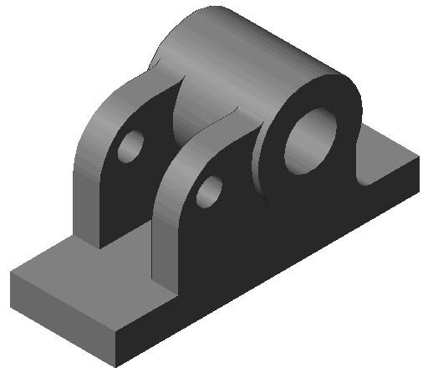
Why Engineering Drawings?
How would you describe this object to others?
Shape.
Size and dimensions
Surface finish
Material
Tolerances
Engineering graphics: To provide unambiguous understanding to all.
A fundamental means of communication: manual or thru computer.

Slide 4
ENGINEERS USE 2D IMAGES BASeD ON ORthOGRAPHIC PROJECTIONS

Slide 5
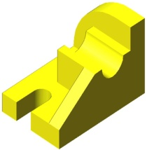
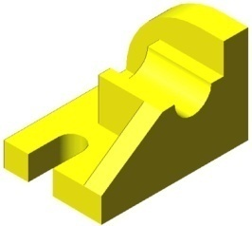
Type of Projections
Picture Plane
Picture Plane
Center of Projection at Infinity
Center of Projection
Perspective or Converging
Parallel

Slide 6
Type of Projections
Lines from coordinate in Original Space to coordinate in Projected Space

Slide 7
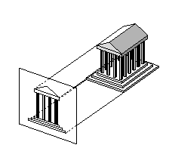
Orthographic Projection
A special type of parallel projection.
Projector lines are not only mutually parallel, but also perpendicular to the plane of projection.
Real world objects are mapped onto a 2D drawing sheet.

Slide 8
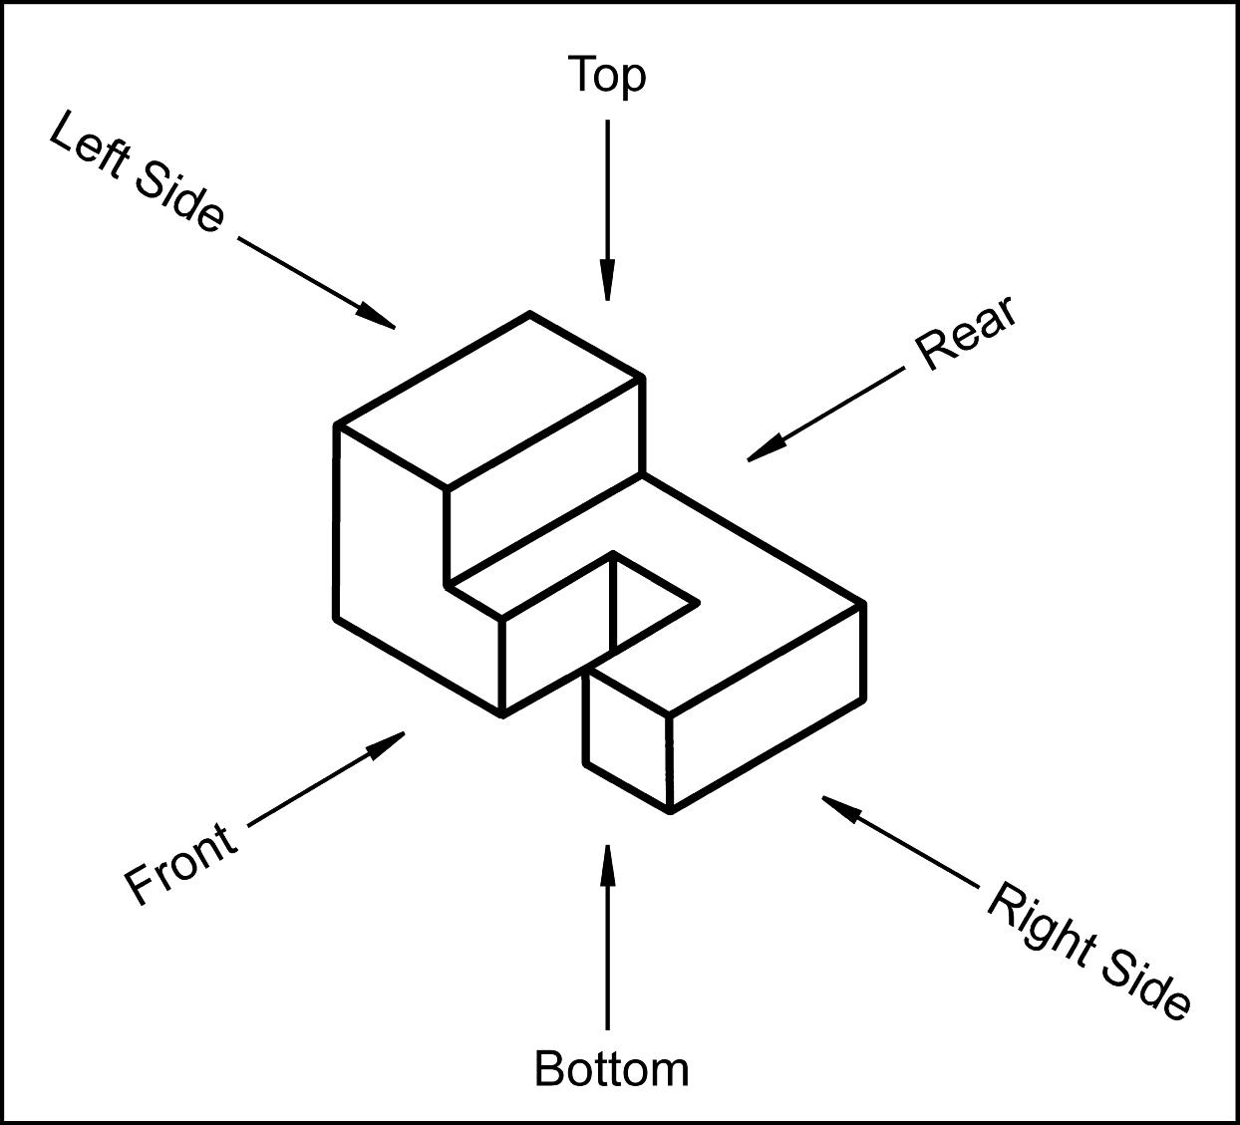
The Six Principal Views
The 6 principal views can be created by looking at the object from different directions.
However, for most objects, three orthographic views are adequate to represent a 3D object.

Slide 9
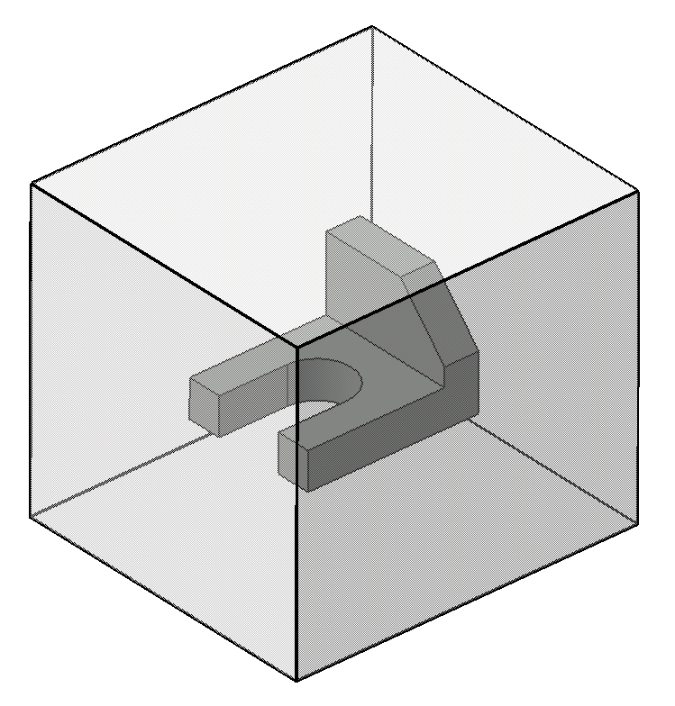
Orthographic Views Third Angle Convention
Imagine the object of study is placed inside a glass box.
The sides of the box represent the 6 planes of projection.
Planes are mutually connected by hinge joints.
Horizontal Pane
Frontal Plane
Profile Plane

Slide 10
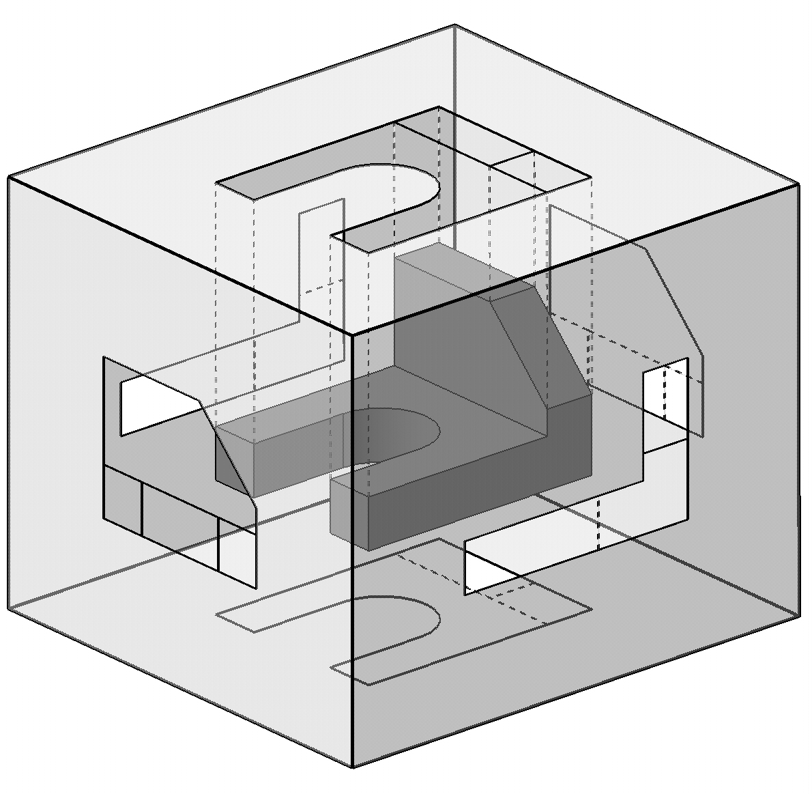
Orthographic Views Third Angle Convention
The image of the object is projected on each of the six sides of the box.

Slide 11
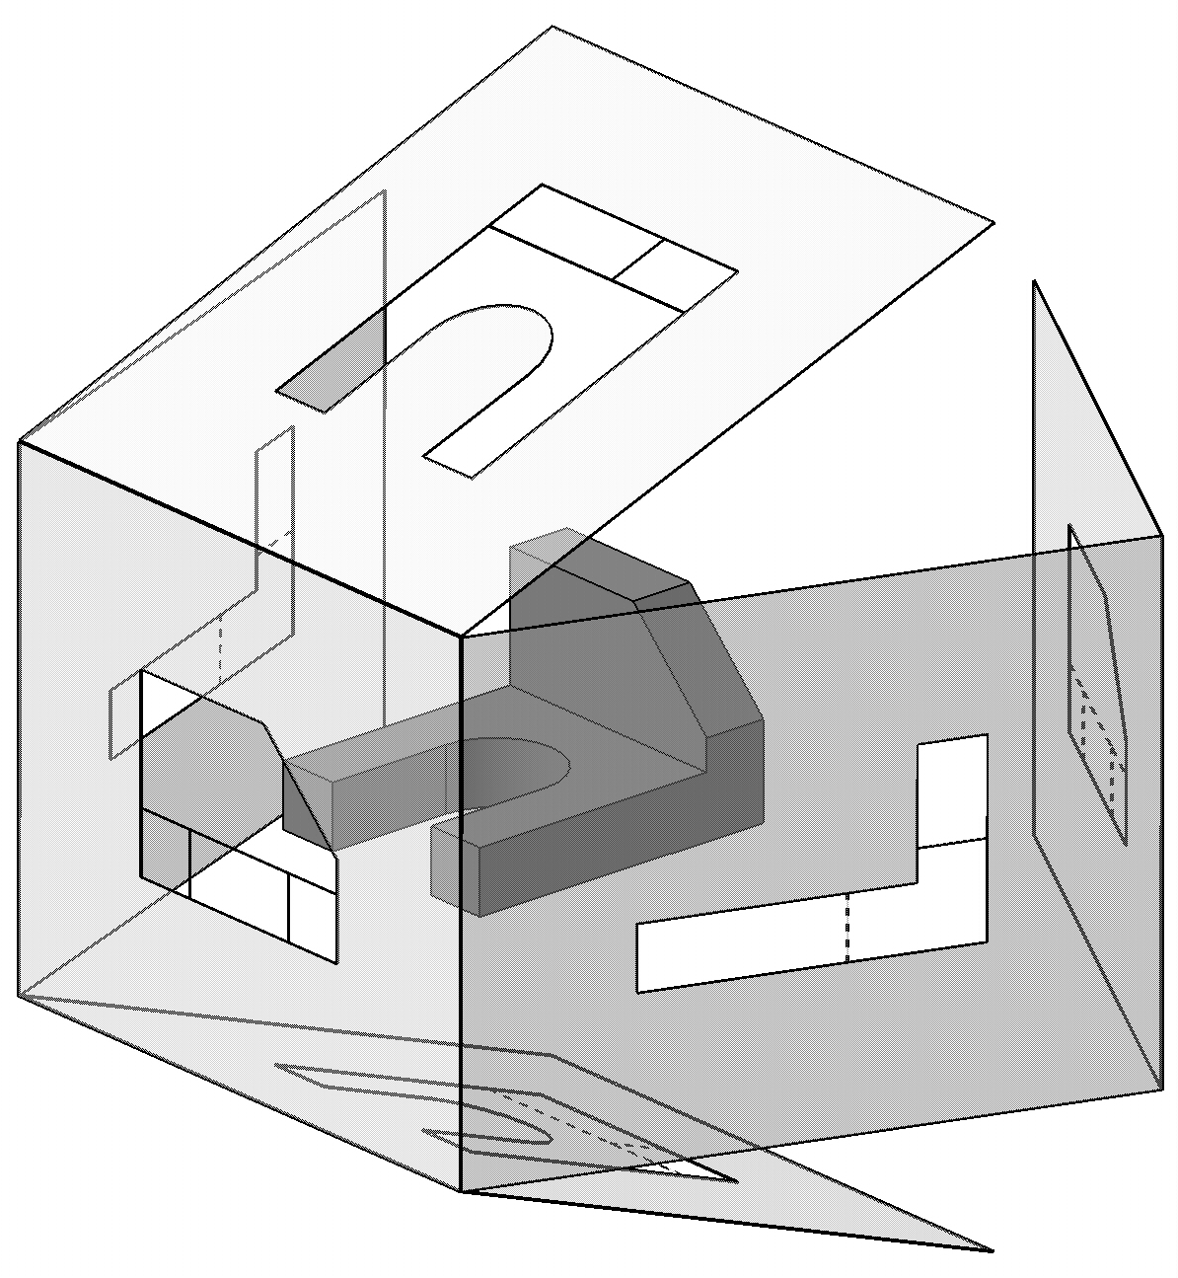
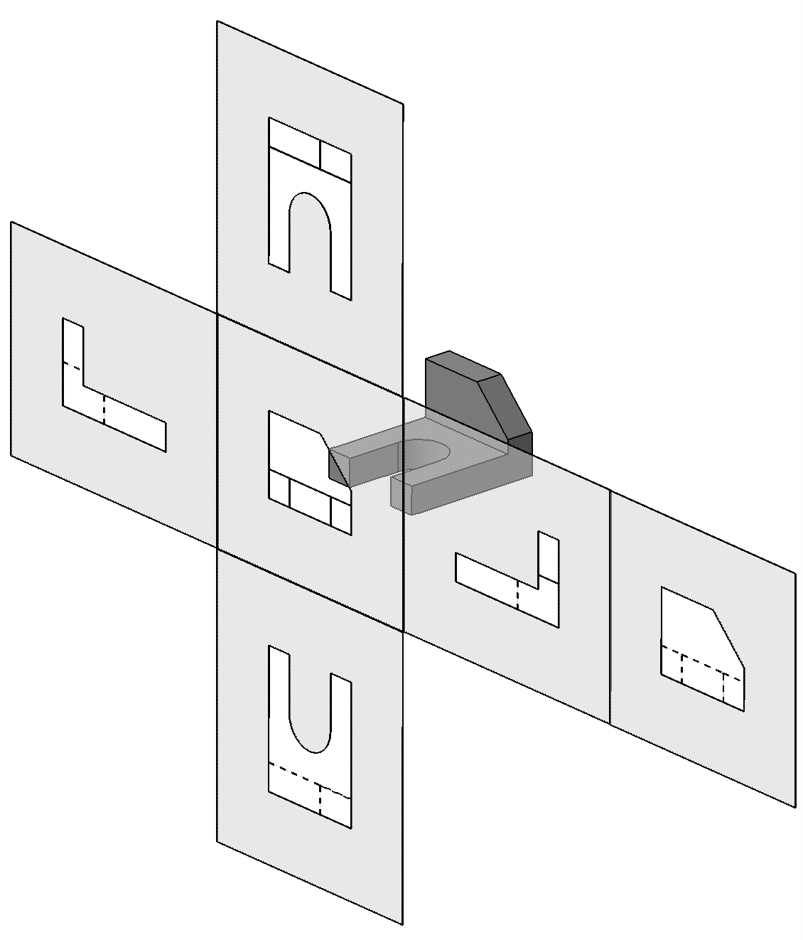
Orthographic Views Third Angle Convention
Next, the box is unfolded creating the 6 principal views as shown below.

Slide 12
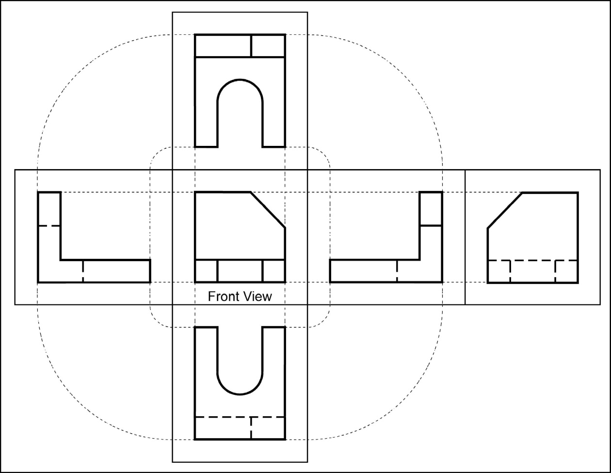
Label the 5 remaining principal views with the appropriate view name.

Slide 13

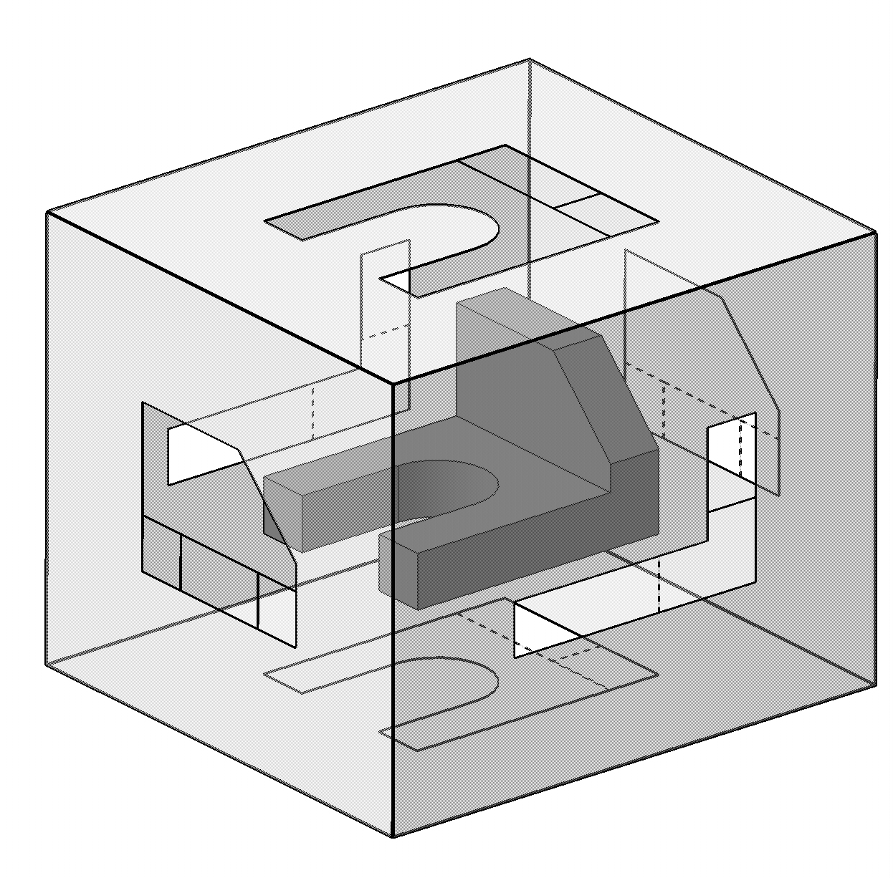
Name each view.
Top

Slide 14
Name each view.
Top
Right Side

Slide 15
Name each view.
Top
Right Side
Rear

Slide 16
Name each view.
Top
Left Side
Right Side
Rear

Slide 17
Name each view.
Top
Left Side
Right Side
Rear
Bottom

Slide 18
What are the differences between the Right Side and Left Side views?
Top
Left Side
Right Side
Rear
They are mirror images with one different line type.
Bottom

Slide 19
What are the differences between the Top and Bottom, and Front and Rear views?
Top
Left Side
Right Side
Rear
They are mirror images with different line types.
Bottom

Slide 20

Top
Left Side
Right Side
Rear
Bottom

Slide 21
Selecting the Right “Front” View
The front view should show maximum number of features of the object.
Should have least amount of hidden lines.
The front view is chosen first and the other views are based on the orientation of the front view.

Slide 22
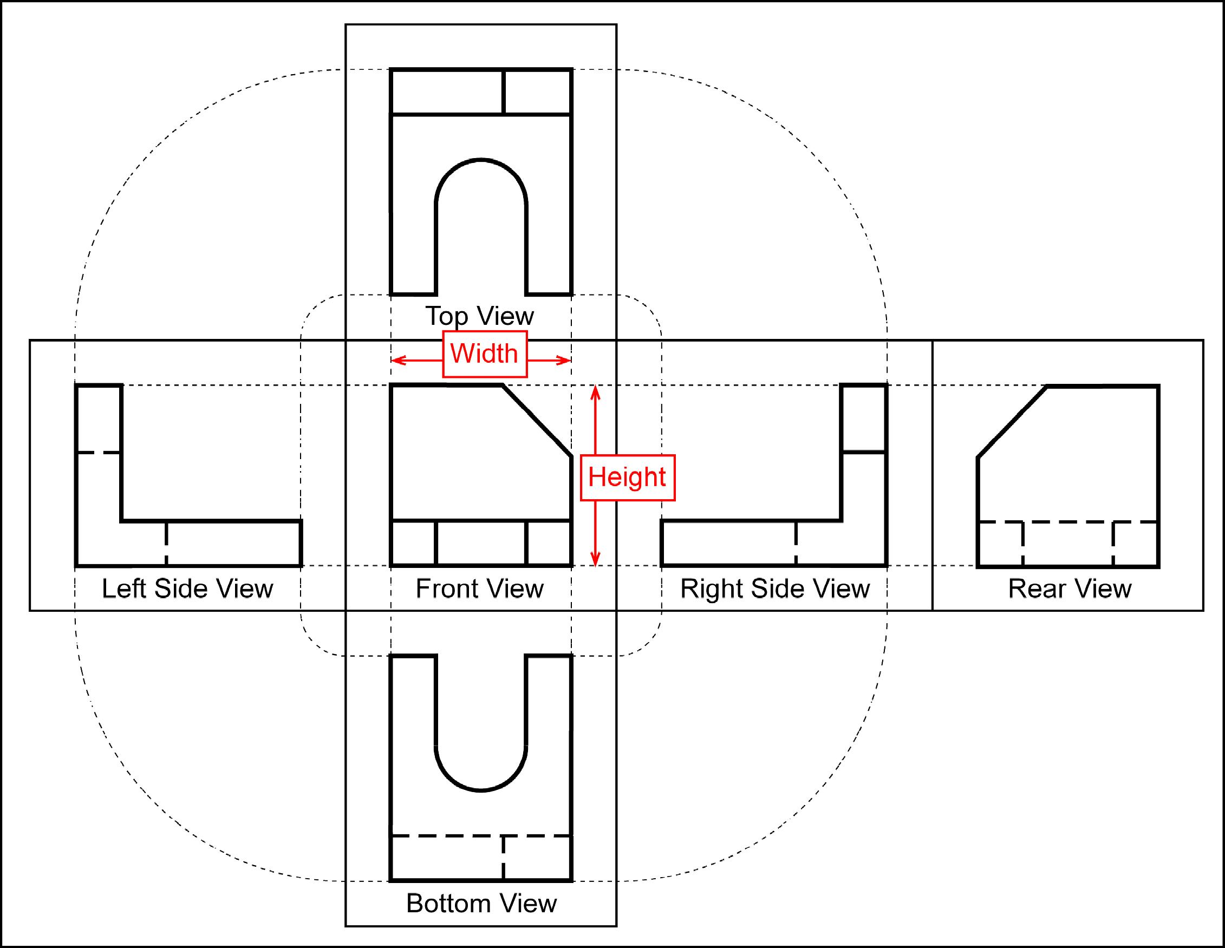
Alignment of Different Views
The top and front views are aligned vertically and share the same width dimension.
The front and right side views are aligned horizontally and share the same height dimension.

Slide 23
Orthographic Projections Third Angle Convention
Object in 3rd quadrant.
Plane of projection is transparent.
Observer -> Plane of projection -> Object.

Slide 24
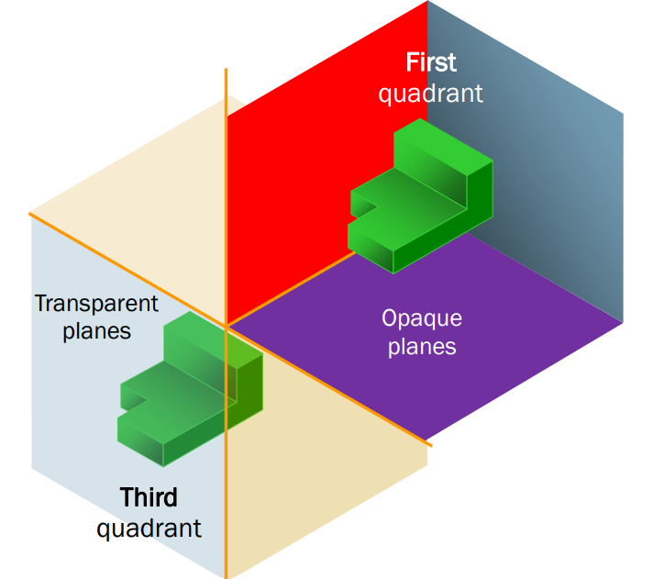
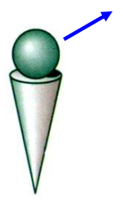
Orthographic Projections Two Conventions
THIRD ANGLE
Object in 3rd quadrant.
Plane of projection is transparent.
Observer -> Plane of projection -> Object.
Front view below horizontal axis.
FIRST ANGLE
Object in 1st quadrant.
Plane of projection is opaque.
Observer -> Object -> Plane of projection.
Front view is above horizontal axis.
Context: Developing the Front View

Slide 25
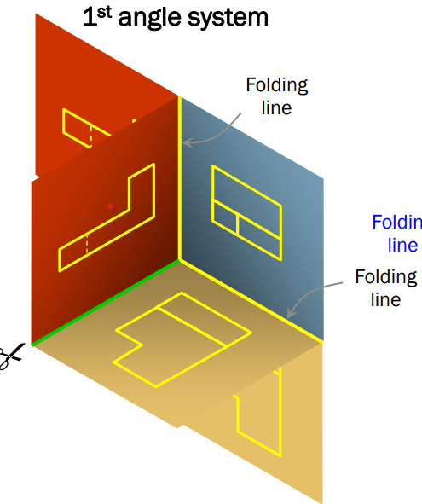
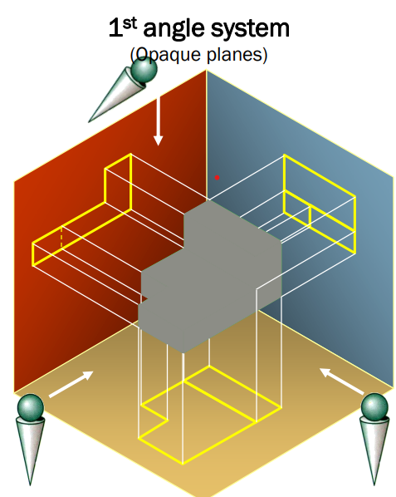
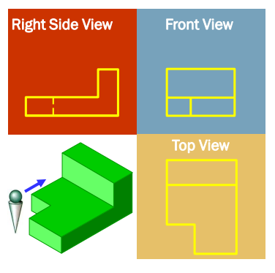
First Angle Convention

Slide 26
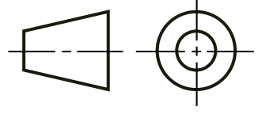
First Angle Convention
Object in 1st quadrant.
Plane of projection is opaque.
Observer -> Object -> Plane of projection.
Front view is above horizontal axis.
Top view below the front view and vice-versa.
Right side view is left of front view, and vice-versa.
Used in India, UK, and parts of Europe. However, BIS is OK with either standard.
Symbolized as

Slide 27
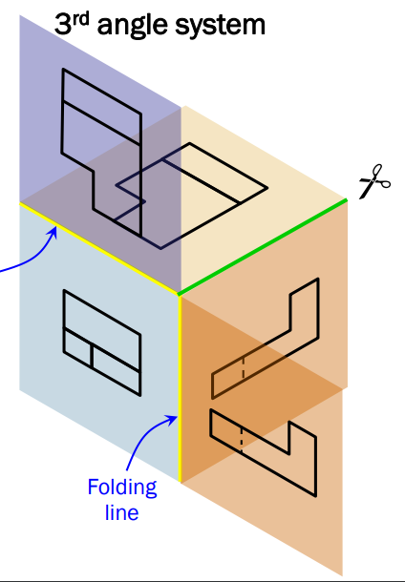
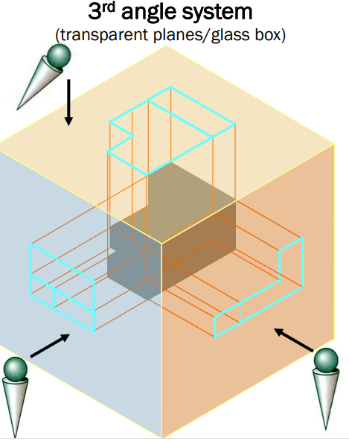
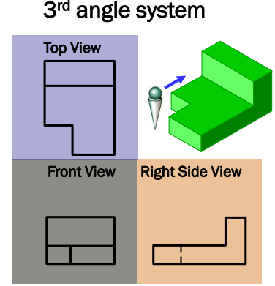
Third Angle Convention

Slide 28
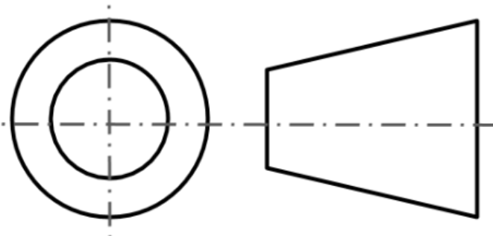
Third Angle Convention
Object in 3rd quadrant.
Plane of projection is transparent.
Observer -> Plane of projection -> Object.
Front view is below horizontal axis.
Top view is above the front view and vice-versa.
Right side view is right of front view, and vice-versa.
Used in USA.
Symbolized as

Slide 29
Line Types
Visible lines
Visible lines represent visible edges and boundaries.
Continuous (0.5 - 0.7 mm).
Hidden lines
Hidden lines represent edges and boundaries that cannot be seen.
Dashed .
Center lines
Represent axes of symmetry.
Long dash – short dash .

Slide 30
Edges
Represent locations where planes/surfaces meet transversally or material boundaries exist!

Slide 31
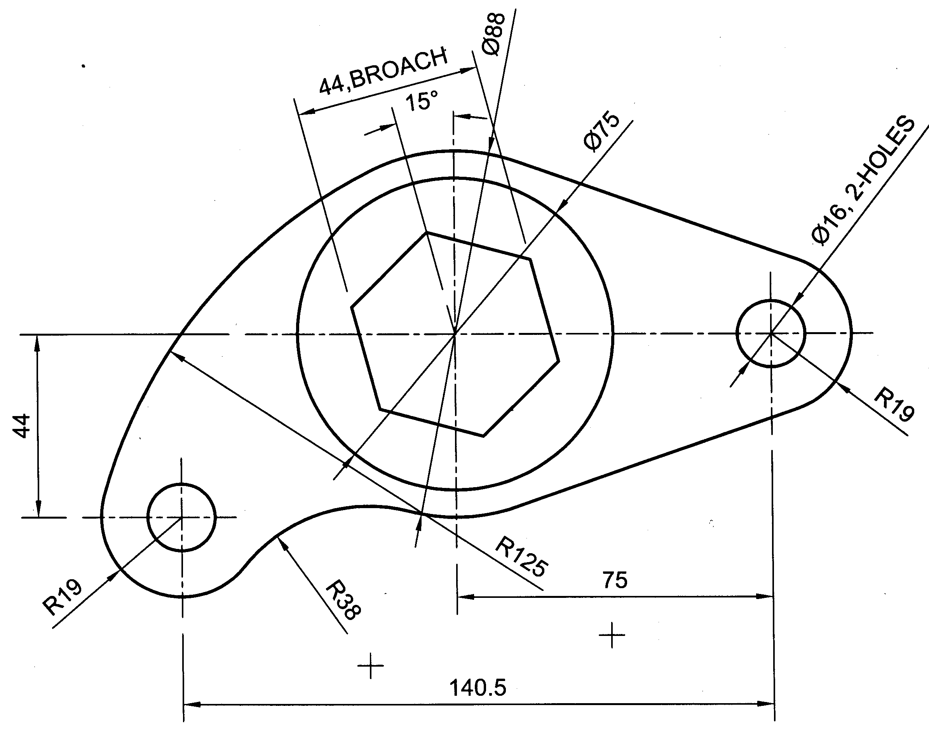
Tangent arcs or tangent lines No edges at tangent points! Smooth transition
Front view without internal details
Would there be lines corresponding to the tangent points?

Slide 32
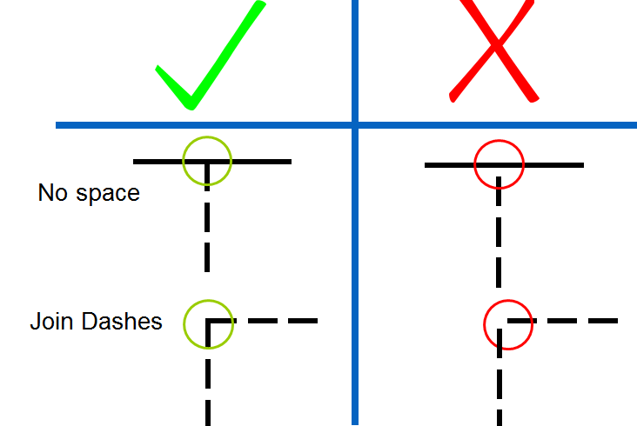
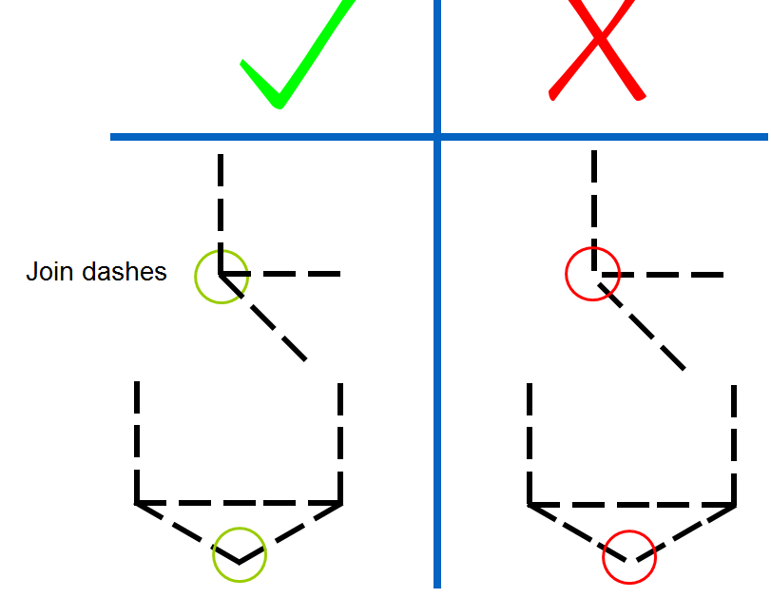
Creating Hidden Lines
Hidden lines represent invisible edges and boundaries.
The length of hidden line dashes may vary slightly as the size of the drawing changes.

Slide 33
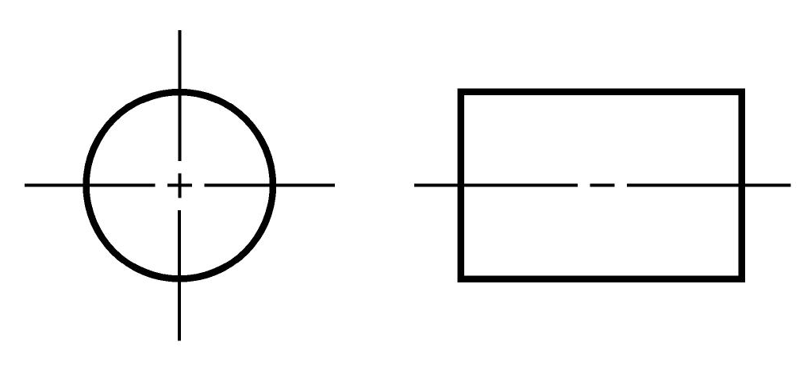
Using Center Lines
Center lines indicate axes of symmetry.
They are important for interpreting cylindrical shapes.

Slide 34
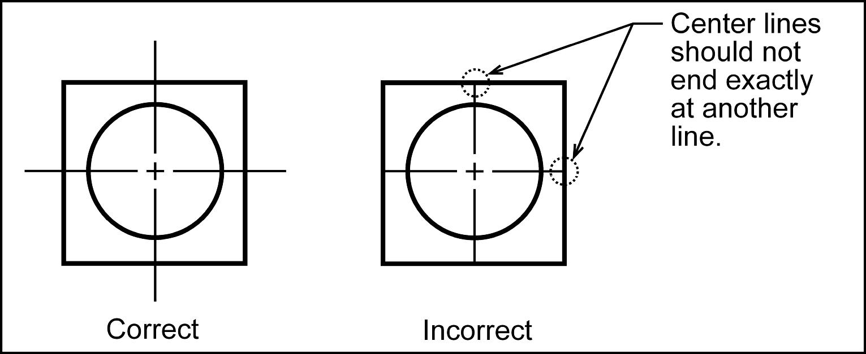
Drawing Center Lines
Extend a little beyond the object or feature.
Start and end with long dashes.

Slide 35
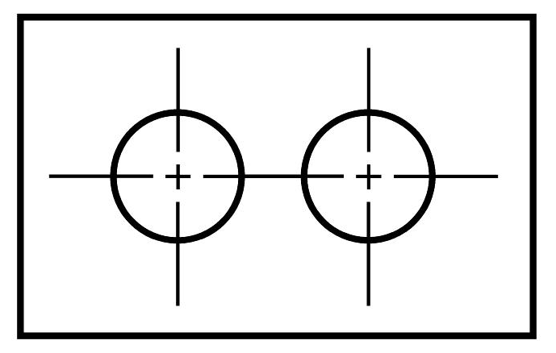
Drawing Center Lines
May be connected within a single view to indicate that two or more features are coplanar.
Should not extend in the space between views .

Slide 36
Hinge/ Folding Lines
✓
❒
Dashes of uniform lengths and spacing

Slide 37
Precedence of Lines
What happens when multiple lines are coincident ?
Priority
Object Line
Hidden Line
Cutting plane/ section line
Center Line

Slide 38
Example

Slide 39
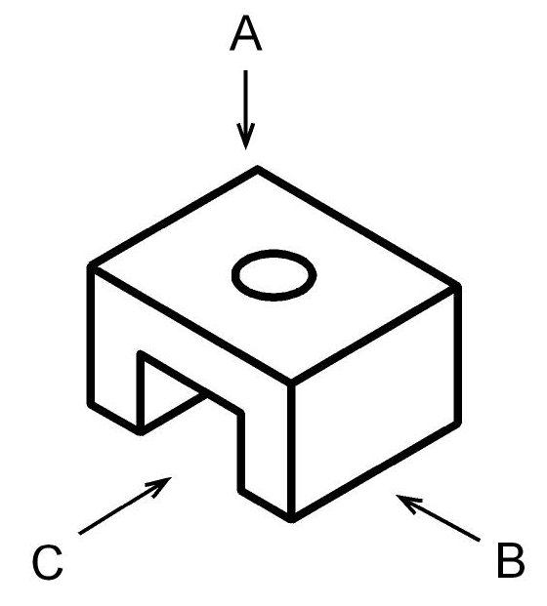
Creating Orthographic Projections
Choose the front view appropriately.
Which view shows the most about the object?

Slide 40
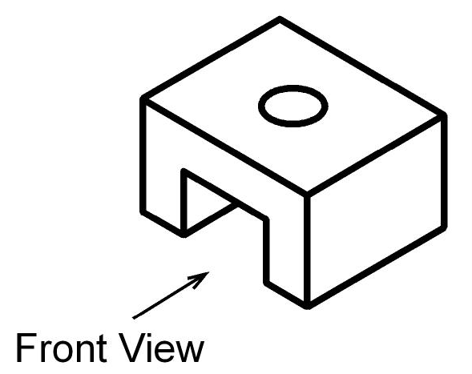
Creating Orthographic Projections
Just for explanation purpose, we will draw all 3 standard views.
How many views are really needed to describe the object completely?
Which are those views?

Slide 41
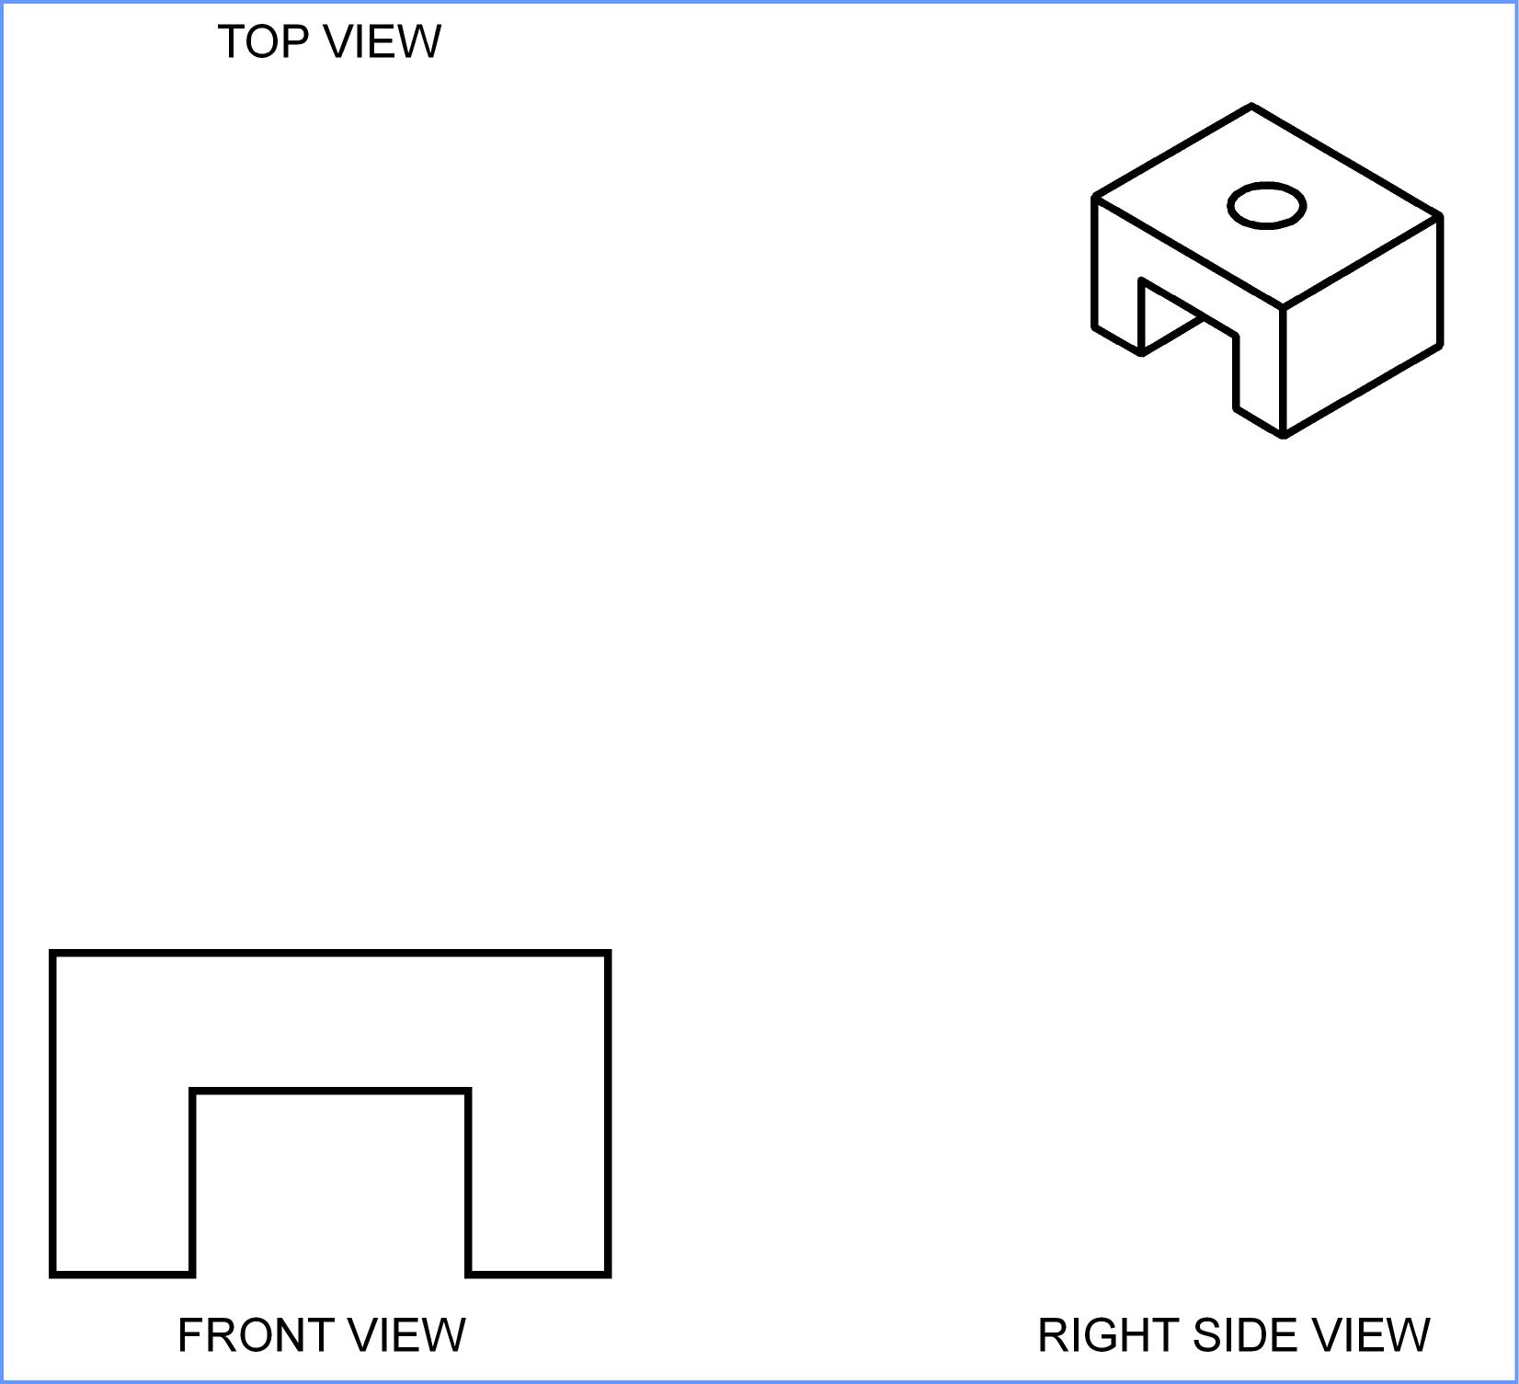
Creating Orthographic Projections
Draw the four quadrants
Draw visible features of the front view.
Folding line

Slide 42
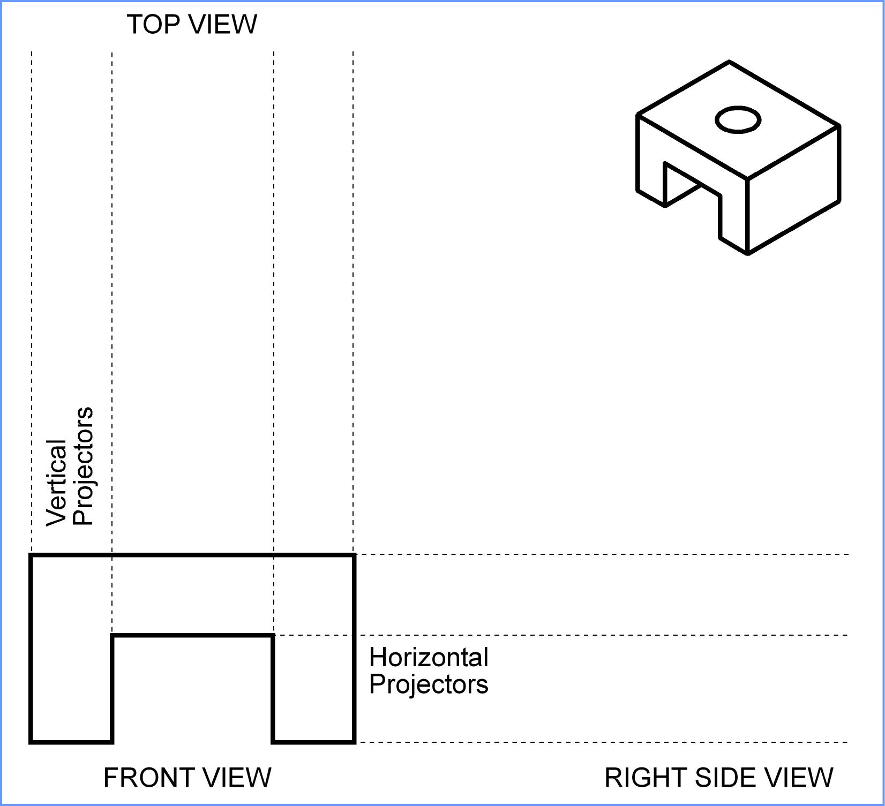
Creating Orthographic Projections
Draw projectors from the front view.
2H pencil
Continuous lines.

Slide 43
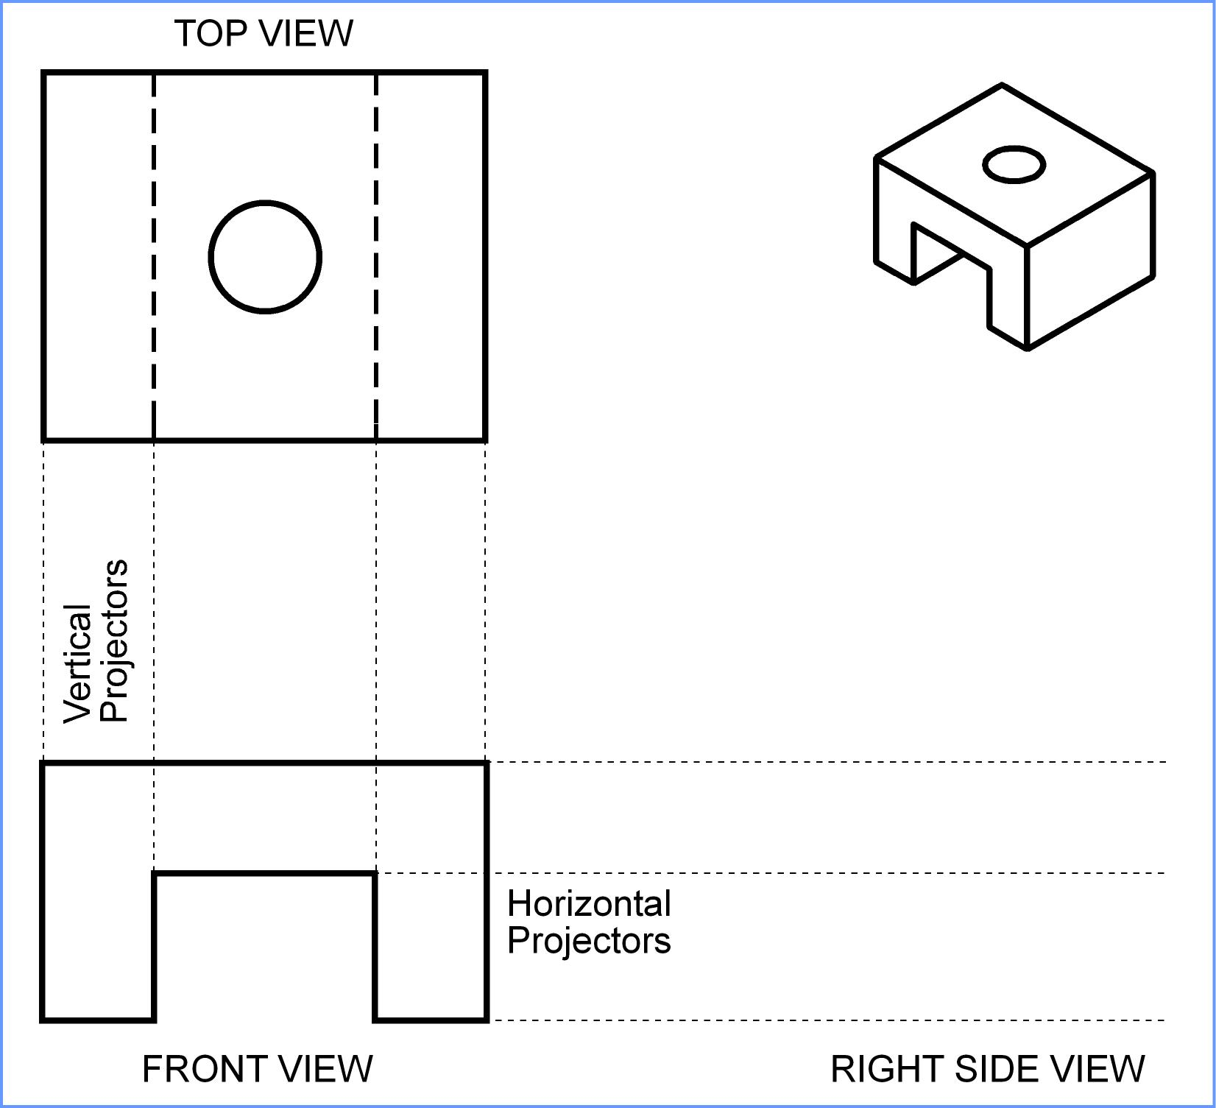
Creating Orthographic Projections
Draw the top view.

Slide 44

Creating Orthographic Projections
Project back to the front view, if required.

Slide 45
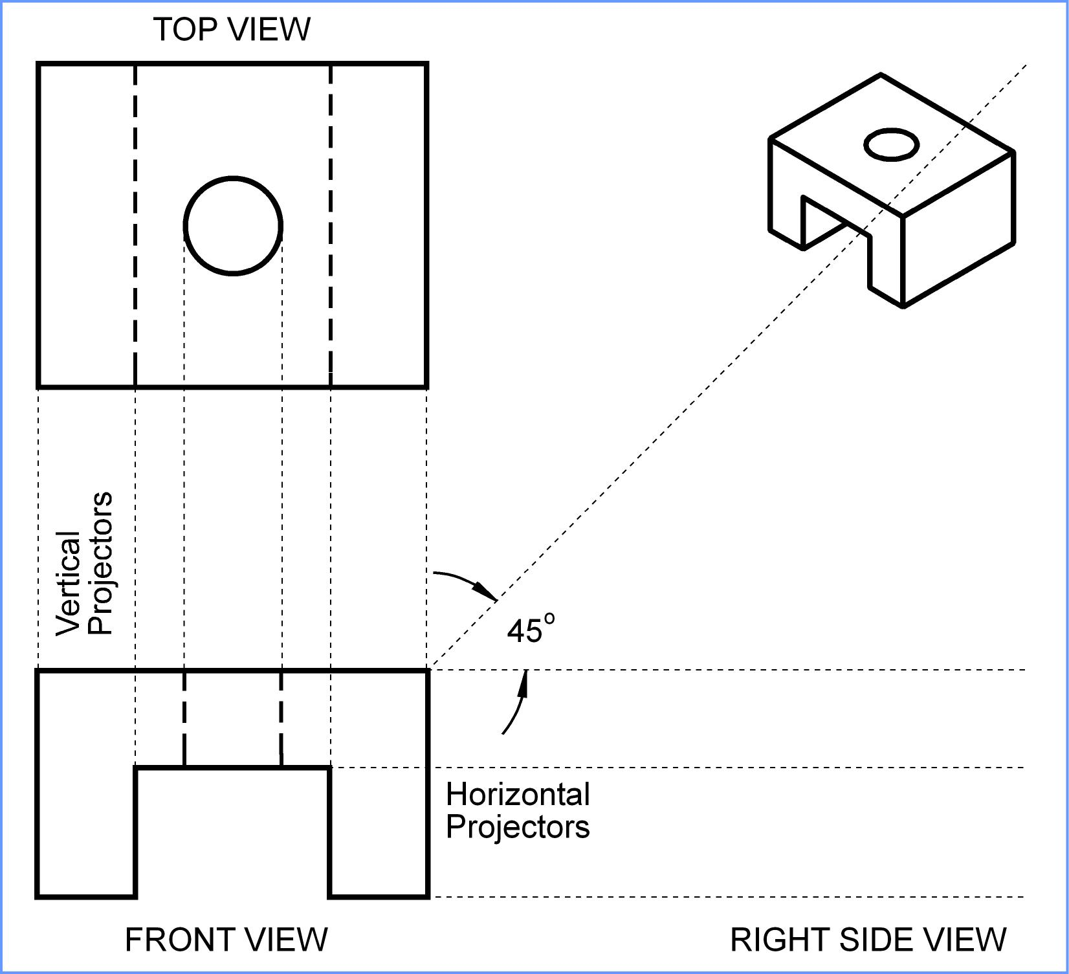
Creating Orthographic Projections
Draw a 45° miter line.
Continuous
2H pencil
Miter
line

Slide 46
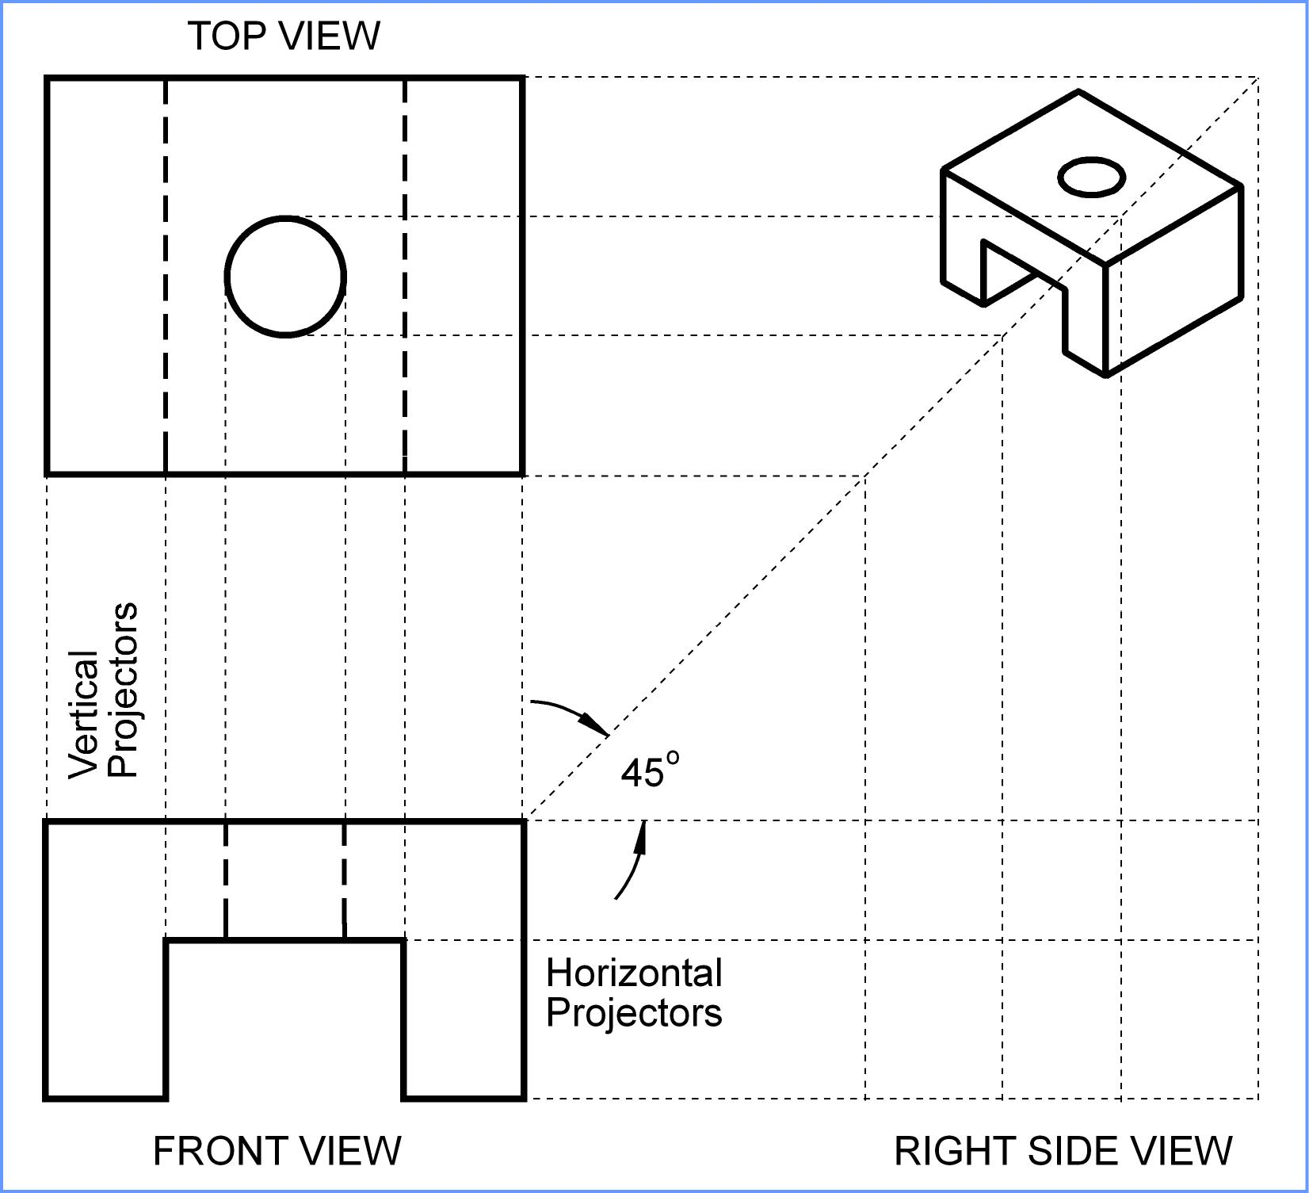
Creating Orthographic Projections
Draw projectors over to the 45° miter line and down to form object feature points.

Slide 47
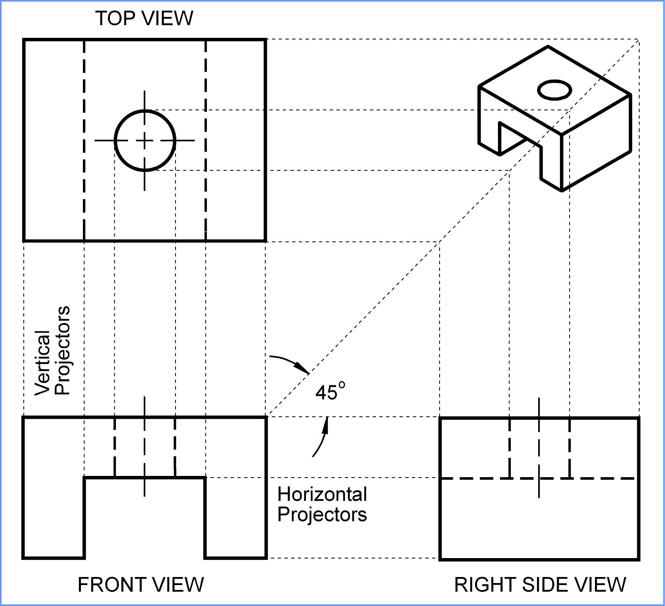
Creating Orthographic Projections
Draw the right side view.
Project back if needed.
Draw centerlines if needed.

Slide 48
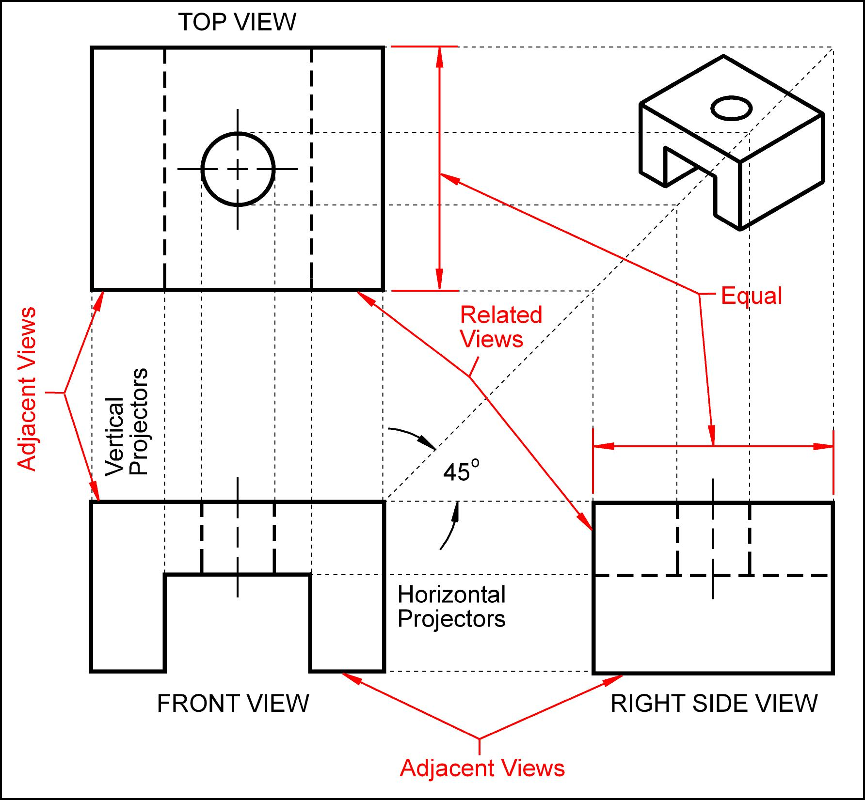
Let us Review What We Drew.

Slide 49
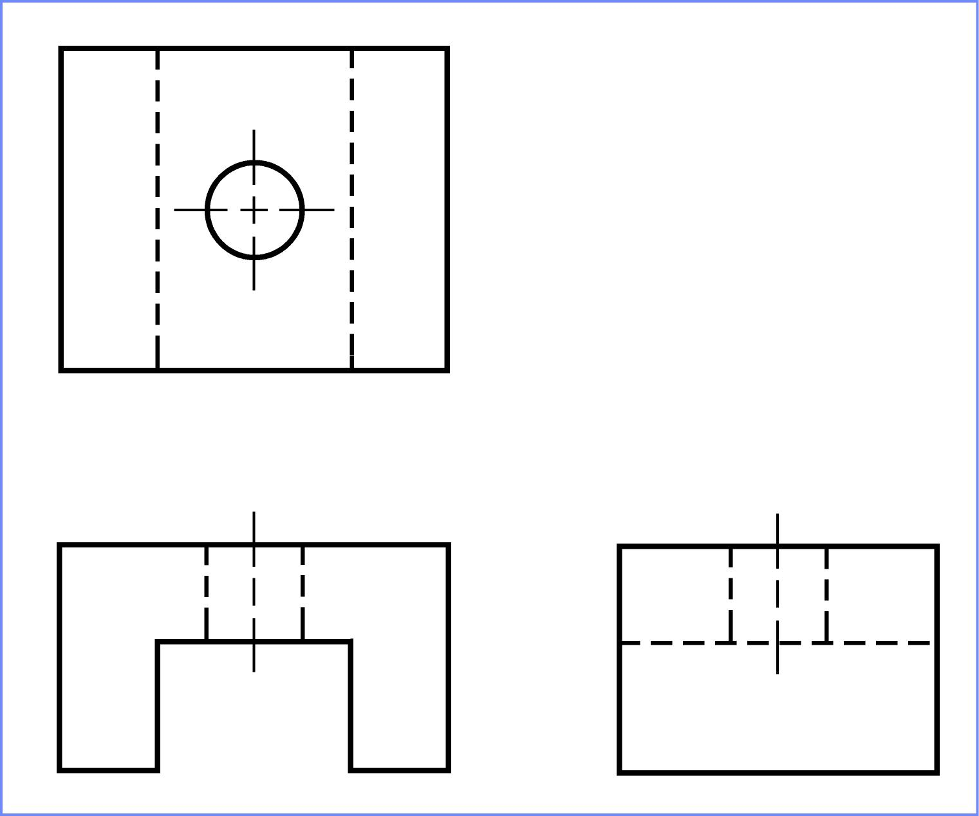
The Final Drawing Third Angle Projection

Slide 50
Exercise

Slide 51
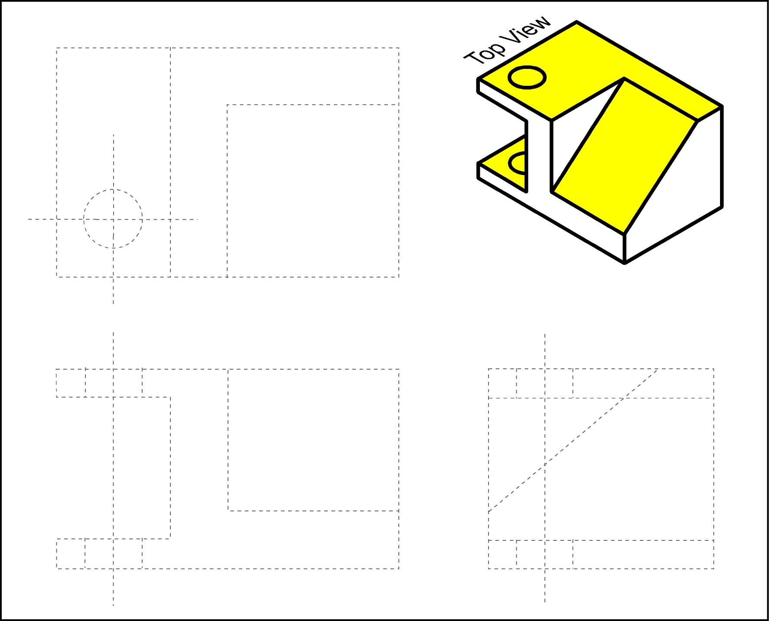
Fill in the visible lines in the top view.

Slide 52
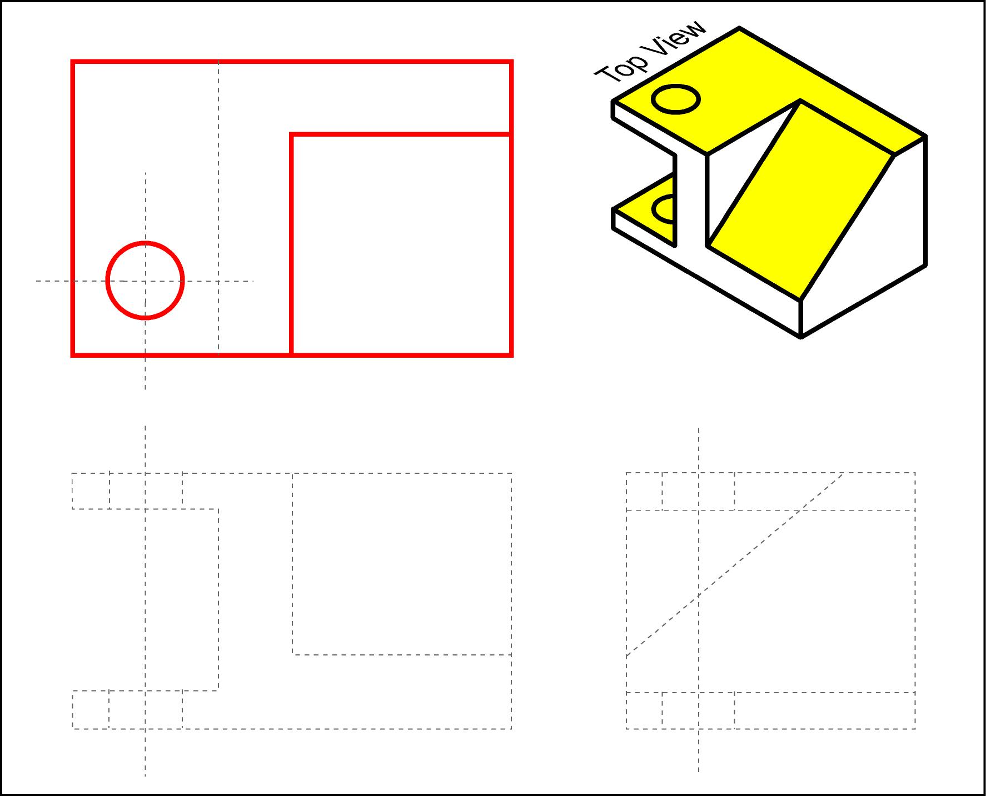

Slide 53
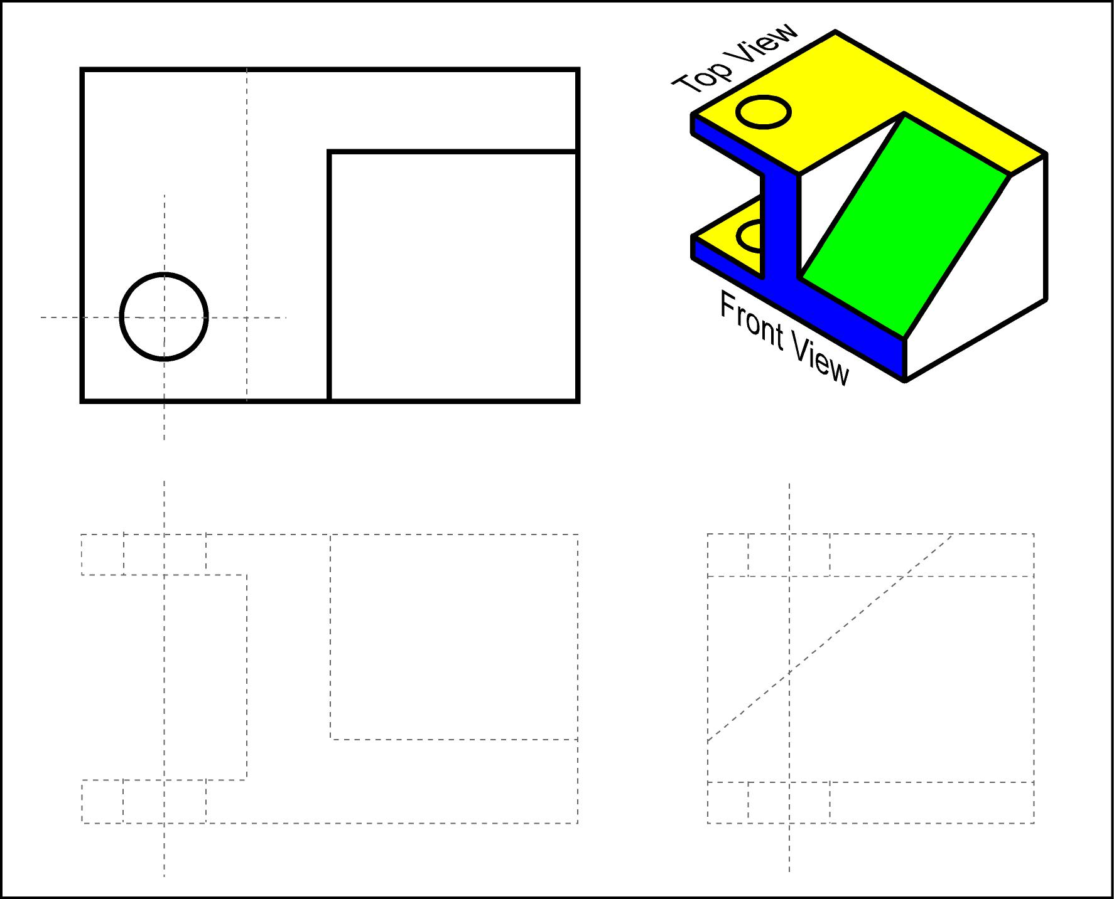
Fill in the visible lines in the front view.

Slide 54
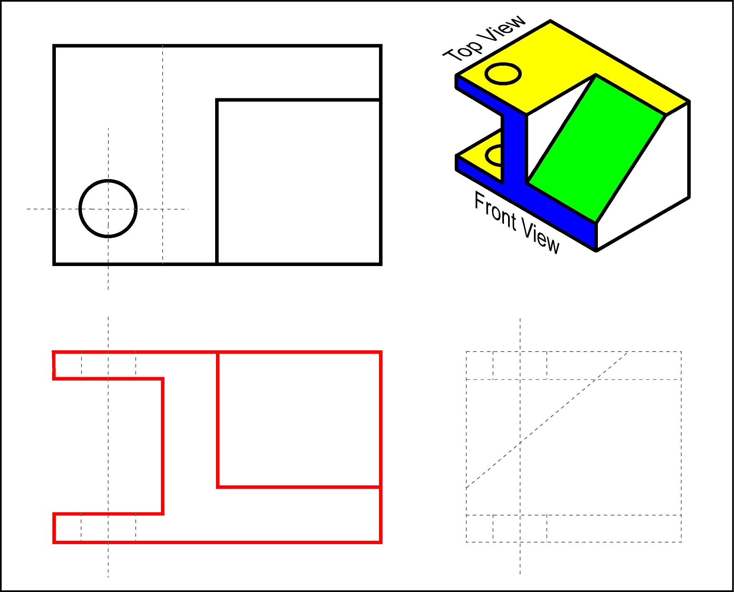

Slide 55
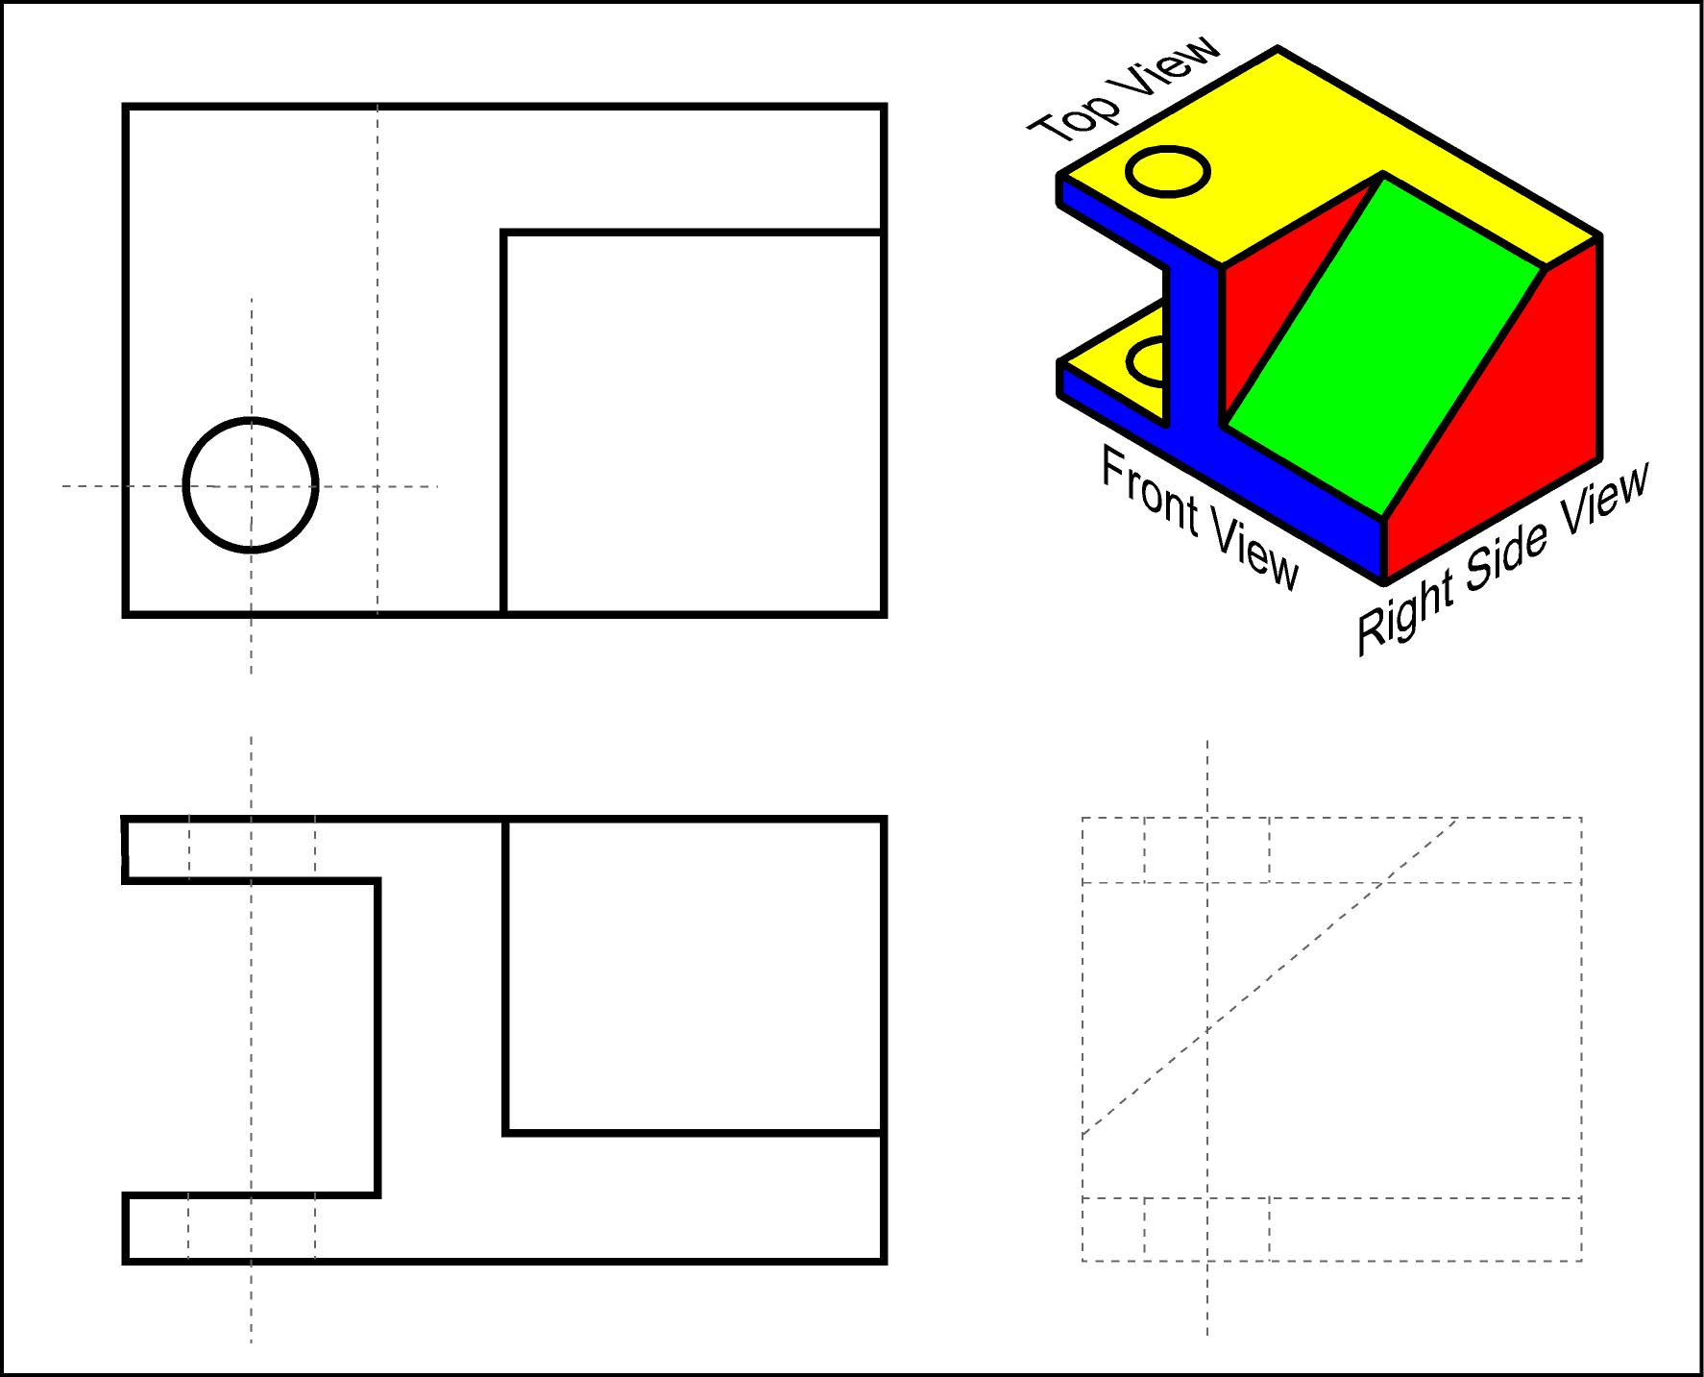
Fill in the visible lines in the right side view.

Slide 56
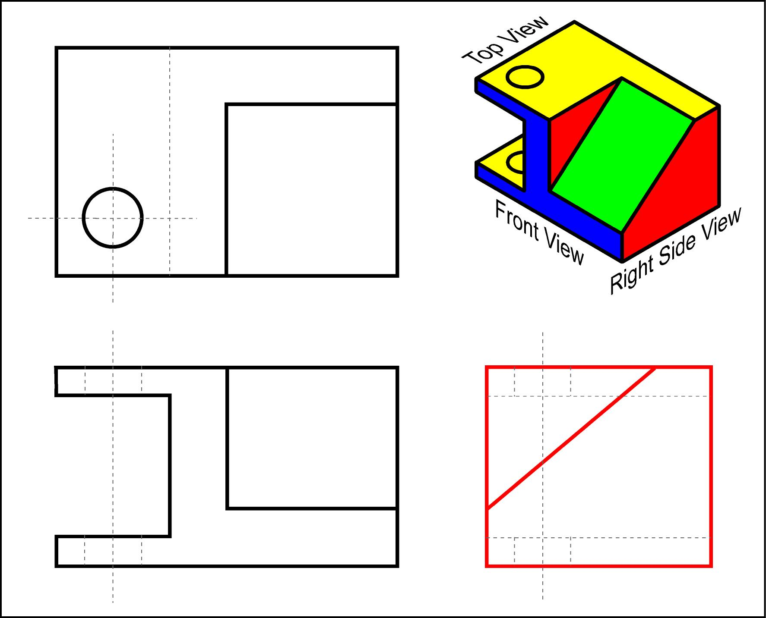

Slide 57
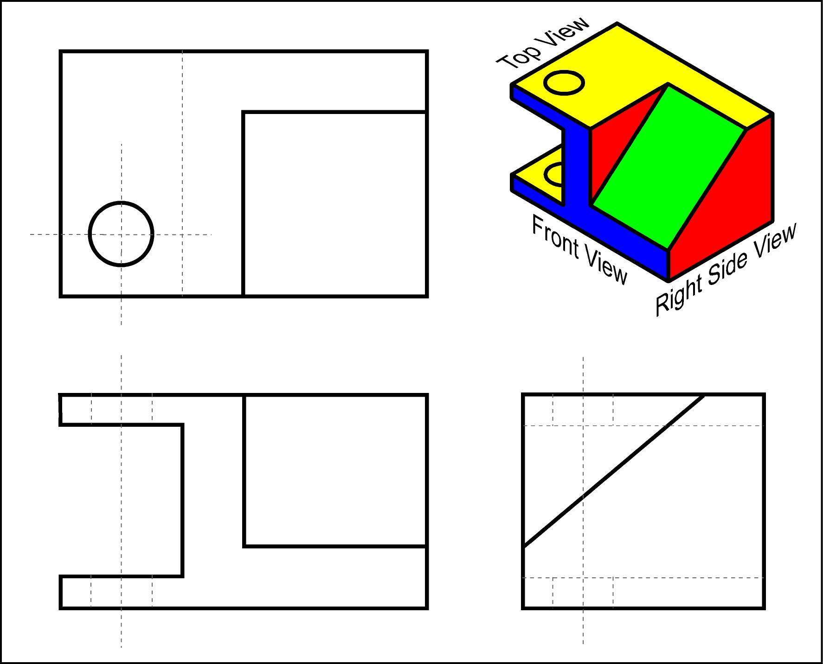
Fill in the hidden lines in all the three views.

Slide 58
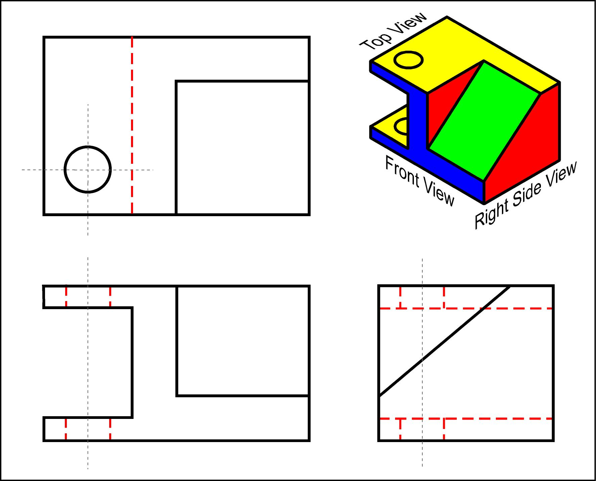

Slide 59
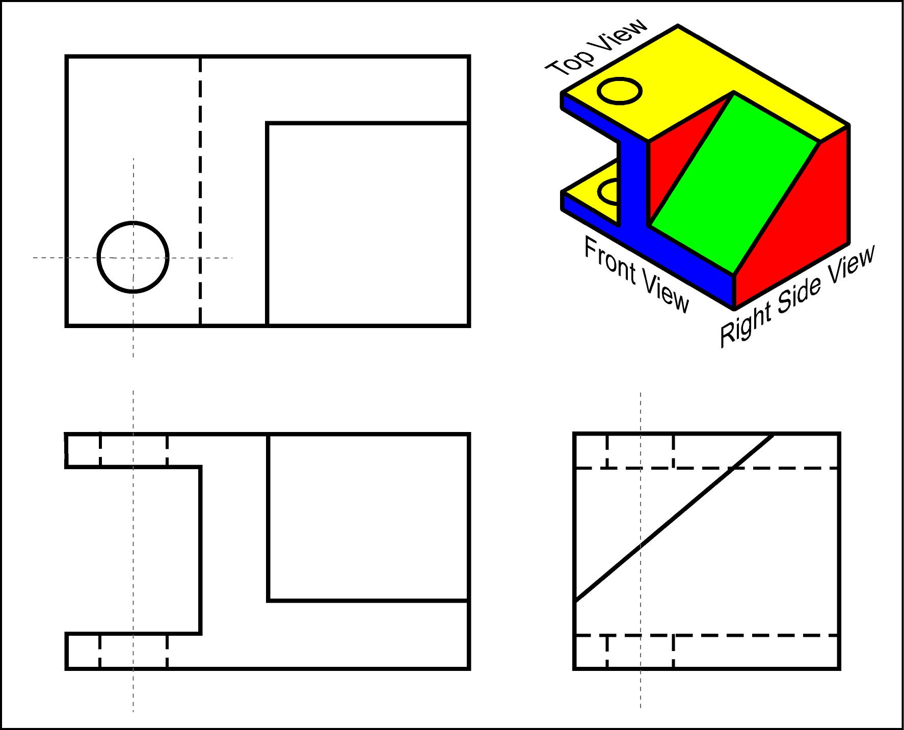
Draw the center lines in all views.

Slide 60
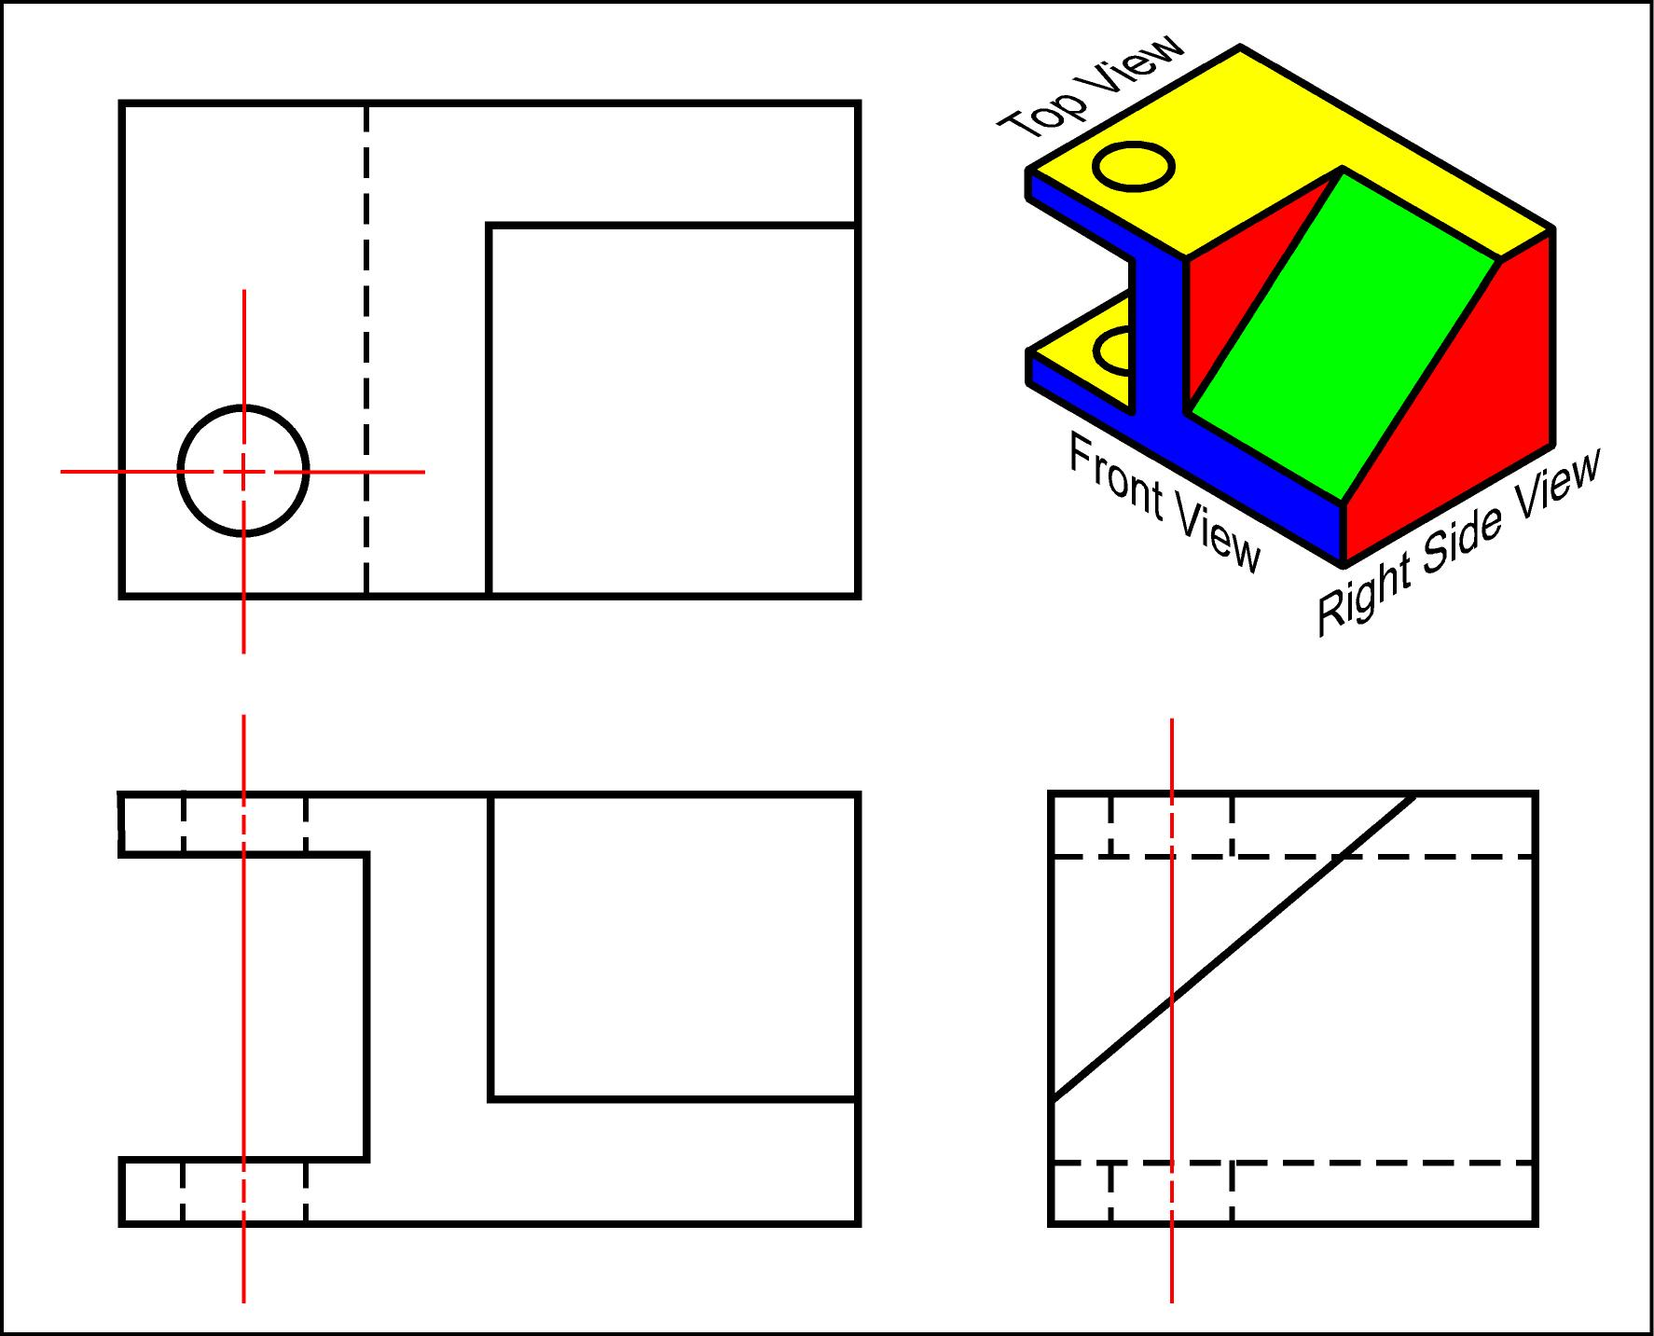

Slide 61
In this course, your should …
leave the construction lines after completing your drawing.
use a 45º miter line for reflecting the views.
use 2H pencil for all construction lines.
use H pencil for object lines, dimensions, writing, etc.

Slide 62
Some objects can be described by just one view.

Slide 63
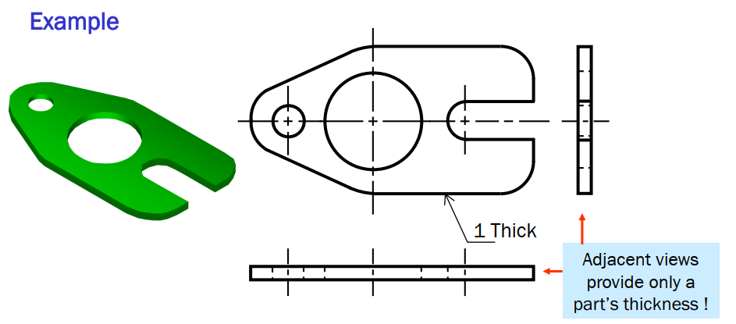
Flat Parts of Uniform Thickness
No extra information provided by these two view.
Not needed.

Slide 64
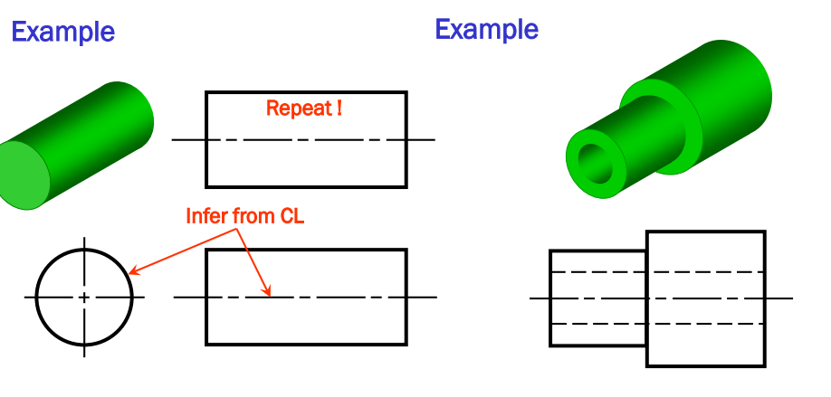
Objects with Circular Cross-sections
Similarly, objects with square cross-sections need only one view.

Slide 65
Some objects can be described by only two views.

Slide 66




Slide 67

Practice Problems

